Slide 1
Synergy between the Erasmus+ Programme and European Social Founds Programme
Katarzyna Aleksy, Director of Higher Education Programs Department, Foundation for the Development of the Education System

Slide 2






Programmes and initiatives
National Agency for the Erasmus+ Programme
erasmusplus.org.pl
In previous years, the Fundation for the Development of the Education System has implemented the “Lifelong Learning Programme” (Erasmus, Leonardo da Vinci, Comenius and Grundtvig) and “Youth in Action” programmes in Poland.
Currently it acts, among others, as:
National Agency for European Solidarity Corps
eks.org.pl
Programme Operator for the Programme Education funded by EEA Grants
education.org.pl
Coordinator of the Polish Eurydice Unit
eurydice.org.pl
Coordinator of the Eurodesk Poland National Office
www.eurodesk.pl

Slide 3









Programmes and initiatives
www.etwinning.pl
FRSE is also responsible for other European programmes and initiatives, such as:
epale.ec.europa.eu/pl
www.europass.org.pl
worldskillspoland.org.pl
euroskills2023.org
www.salto-youth.net/rc/eeca
www.wymianymlodziezy.frse.org.pl

Slide 4
How do we get funds for projects?
The EFS Managing Authority consults with the European Commission on the funding assumptions for types of activities for the given financial perspective.
The program documents for the years 2021-2027 include a description of activities eligible for funding under the Transnational Mobility Programs, based on the principles established for the Erasmus+ program.
Foundation for the Development of the Education System (FRSE) submits proposals to the Managing Authority in a non-competitive mode.

Slide 5
How do we get funds for projects?
European Social Fund
The "main" project with calls for proposals
Foundation for the Development of the Education System
Managing Authority - Ministry of Development Funds and Regional Policy (MFiPR)
Financing Erasmus projects according to agreed model
Beneficiary
Beneficiares

Slide 6




How do we get funds for projects?
FRSE submits to the Managing Authority a proposal for the "main" project including calls in the Erasmus + program.
The proposal undergoes a full formal and content assessment at the Managing Authority.
After approval of the proposal, an agreement is signed between the FRSE and the Managing Authority.
The agreement includes the Payment schedule. It specifies the method of transferring funds for FRSE in quarters.

Slide 7
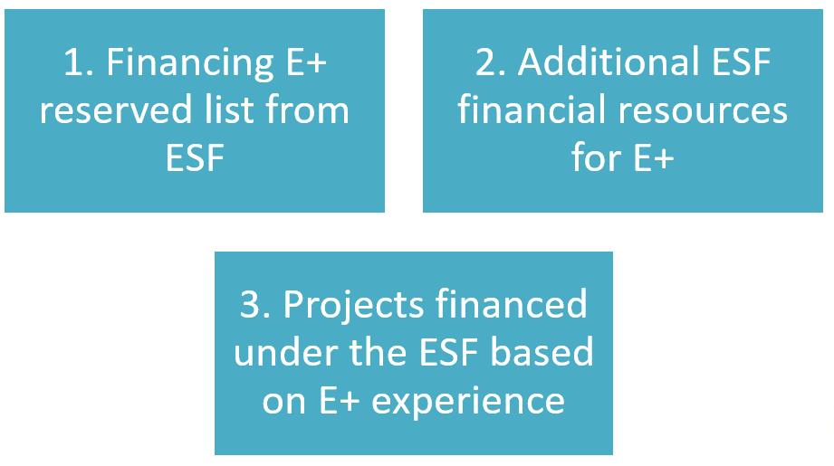
Types of synergy

Slide 8
Description of the project Financing E+ reserved list from ESF
Submission of applications
to Erasmus + program
ERASMUS+
Formal and substantive assessment
ERASMUS+
Main list
ERASMUS+
Reserved list
[chosen projects depending on budget limit]
ESF

Slide 9
Description of the project Additional ESF financial resources for E+
Submission of applications to Erasmus + program
ERASMUS+
Co-financing under the E+ program
ERASMUS+
additional financial resources for students with disabilities and those in a difficult financial situation
ESF
Formal and substantive assessment
ERASMUS+

Slide 10
Description of the project Projects financed under the ESF based on E+ experience
Submission of applications to EFS project (FRSE)
Projects financed under the ESF
Experience from Erasmus+
and LLP
Formal and substantive assessment

Slide 11
Fund Synergy Best Practices: The Case of Synergy between Erasmus+ and ESF
Since 2007-2013, the FRSE has been introducing the innovative concept to complement funding opportunities within the Erasmus+ Programme and ESF.
The concept has been successfully applied in Poland to all sectors of education as the international mobility is concerned.
Erasmus + ESF = SYNERGY
more co-financed and implemented projects
reducing administrative burden for beneficiaries and programme operator
more feasible achievement of aims of programmes at the national and EU level
complementarity of objectives
one call for proposals for both sources of funding
unified (Erasmus+) operation rules

Slide 12
From idea to action: the journey of Erasmus+ Programme and ESF
Activities covered by both programmes:
Student and staff mobilities
Job shadowing
Teaching/training assignment
Pupils exchange
Participation in structured courses or training events abroad for all participants
Mobility in VET providers and companies abroad

Slide 13
Description of the project
ESF funding, but Erasmus+ standards and rules
Beneficiaries do not need to submit specific proposals. Projects are selected for ESF funding from the reserve list of the relevant Erasmus+ call
Procedures and tools for contracting, developing and reporting the ESF projects are adopted from Erasmus+
Results are the same as in case of standard Erasmus+ projects
Beneficiaries greatly appreciate additional funds because they know that their chances for project implementation are much bigger. This is especially important for newcomers – organizations not experienced in submitting an applications
In some years more projects were financed from the reserve list with the use of ESF funds than from the main list with the use of Erasmus+ funds

Slide 14
Description of the project - Financing E+ reserved list from ESF [SE]

Slide 15
Description of the project – Financing E+ reserved list from ESF [VET]

Slide 16
Difference between Erasmus and ESF
currency in PLN
participant database - more detailed data about participants for reporting purposes
appropriate visualization - Erasmus+’s logotypes are not allowed to be used
quarterly reports to the Ministry of Investment and Economic Development describing the progress of the project (information about participants, activities, financial issue, indicator success rate)
additional structure and staff members with specific ESF knowledge
different data bases, different contracts

Slide 17
Our recommendations
Be involved at the stage of negotiations
National ESF startegy according to Erasmus priorities
Do the same as in Erasmus and ESC – simplification in practice
Think about additional ESF projects to fill the gap in your country/sector
Lobbing synergy in Brussels

Slide 18
Thank you
for your attention!

